Slide 1
Catering Growth Plan
the road to $40,000 by 2027
ANATOLIA
CATERING
Hand selected. Halal. Over coal.
Prepared by Jason Rivera . run from the Main Street kitchen with Yusuf
Planning note, December 2025

Slide 2
MOMENTUM
Where catering revenue is heading
Up 64% in 2025
From $11K to $18K in a single year, with no advertising, all word of mouth across the Turkish community.
The 2027 goal needs a dedicated menu, online ordering, and a second insulated van.
Revenue in thousands.
2 / 7

Slide 3
THE MIX
What we cater, by share of events
Weddings
Largest tickets, $4,000 and up, Jason on the grill
Engagement and circumcision
Steady community bookings through the year
Corporate lunches
Fastest growing, weekday volume, repeatable
Community events
Cultural center and mosque, relationship work
3 / 7

Slide 4
PACKAGES
Menus and per guest pricing
Package | Per guest | Includes | Best for
Mezze and grill | $26 | Two mains, mezze, pilav, tea | Smaller parties
Full Turkish buffet | $32 | Four mains, iskender, dessert, tea | Weddings
Corporate lunch | $18 | Platters, wraps, baklava, delivery | Offices
Community rate | $14 | Grill, pilav, bread, tea service | Cultural center
Staff, delivery, setup, and breakdown are included within twenty miles of Paterson. A deposit holds the date and the balance is due seven days before the event. All meat is halal and we do not serve alcohol.
4 / 7

Slide 5
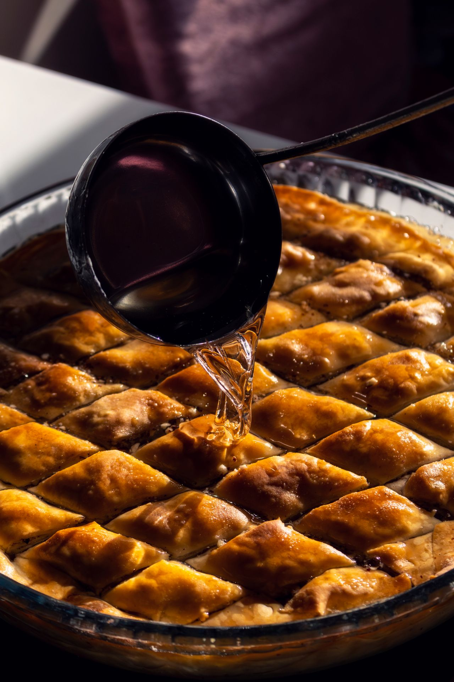
LEVERS
What moves the number
Dedicated catering menu
70%
Online ordering and deposits
45%
Second insulated van
25%
Corporate client list
55%
5 / 7

Slide 6
ROADMAP
Milestones to 2027
Late 2025
Build the dedicated catering menu and pricing
Mid 2026
Add the second insulated van for parallel events
Early 2026
Stand up online ordering and deposit collection
2027
Reach $40,000 and a repeatable corporate pipeline
6 / 7

Slide 7
Feed more families, grow the table
Catering is the side of the business that scales without a second dining room. The plan keeps it personal, keeps it halal, and keeps Jason on the grill for the events that matter.
412 Main Street, Paterson . (973) 555-0400 . jason.rivera@Finthesiss.ai

